Slide 1
Charity
A charity is an association that helps the poor and needy and helps donors to identify those in need.
Tables:
1-employees:
Employee table contains:
A-employee id. B-first name. C-last name. D-gender. E-address. F-age.
S-salary. H-date. J-email. U-phone. P-job.
Donors table contains:
2-donors.
A- id. B-first name. C-last name. D-gender. E-address. F-age.
S-resource. H-date. J-email. U-phone. P-type of donation.
3-needy.
needy table contains:
A-id. B-first name. c-last name. e-date. F-type of supply. G-status.
h.-income. I –address. y.-type of needy people.

Slide 2
4-zakat and alms.
It’s contains:
A-zakat id. B-first name. C-last name. d-date. E-national id. G-type of zakat.
5-suppliers.
Suppliers table contains:
A- id. B-first name. C-last name. D-gender. E-address. F-age.
S-salary. H-date. J-email. U-phone. P-job.

Slide 3
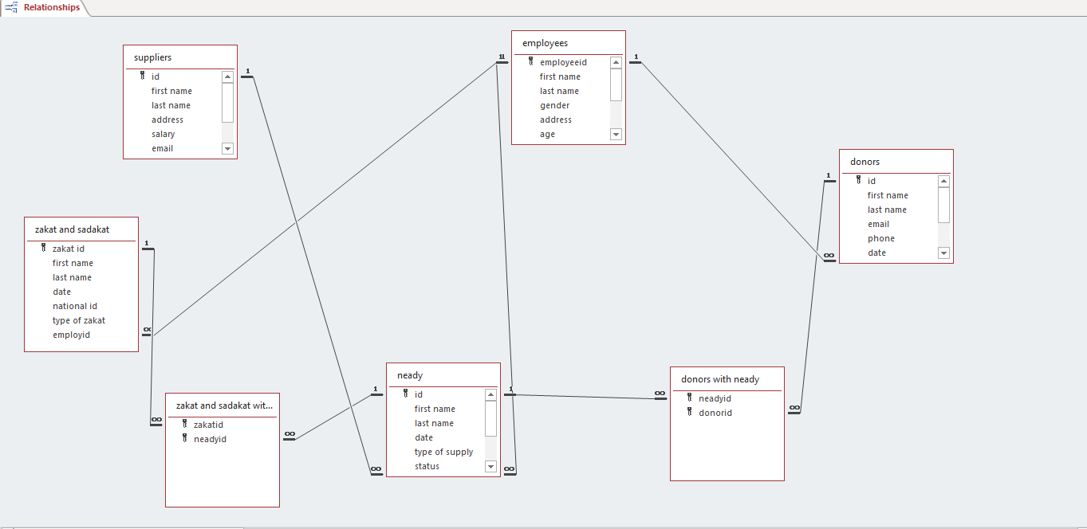

Slide 4
Relations
There are seven relations between tables :
1-relation between employees and donors.
2-relation between employees and zakat and alms.
3-relation between employees and suppliers.
4-relation between employees and needy.
5-relation between needy and donors.
6-relation between zakat and needy.
7-relation between suppliers and needy.

Slide 5
queries
The are nine queries:
1-employees salary between 2000 and 5000.
2-needy that are married.
3-emploayee's income less than 500.
4-donors that donate with clothes and money
5-zakat that give Plants and fruits.
6-full name employees.
7-update employees salary.
8-update suppliers salary who live in Cairo.
9-delete employee that is above 50 years.

Slide 6
Forms
There are five forms:
1-employees form.
2-suppliers form.
3-zakat and alms form.
4-needy form.
5-donors form.

Slide 7
Reports
There are five reports:
1-employees report.
2-suppliers report.
3-zakat and alms report.
4-needy report.
5-donors report.

